Slide 1
COUPON PURCHASE ANALYSIS
Submitted in the partial fulfillment for the award of the degree of
BACHELOR OF ENGINEERING
IN
COMPUTER SCIENCE ENGINEERING WITH SPECIALIZATION IN ARTIFICIAL INTELLIGENCE AND MACHINE LEARNING
Submitted by:
Akash Kapoor - 21BCS10159
Dharmesh Gidwani - 21BCS10745
Divyanshi Bhatia - 21BCS10831
Jashandeep Singh - 21BCS7554
Jasleen Kaur - 21BCS11176
Under the Supervision of:
Mr. Nirmalya Basu
Department of AIT-CSE
DISCOVER . LEARN . EMPOWER

Slide 2
Outline
Introduction to Project
Problem Formulation
Objectives of the work
Methodology used
Results and Outputs
Conclusion
Future Scope
References

Slide 3
Introduction to Project
Retailers and online retailers utilize coupons as an effective digital marketing technique.
For marketing initiatives to be successful, coupon redemption rates must be predicted.
Tailored promotions improve client satisfaction and loyalty.
E-commerce businesses require effective coupon targeting since they incentivize purchases.
For the purpose of projecting coupon purchases, research emphasizes advanced machine learning.
Developing targeted and effective discount promotions is the goal.
In e-commerce, e-coupons offer discounts and flexibility.
Compared to conventional paper coupons, they are more practical and efficient.

Slide 4
Problem Formulation
Formulation of the Problem: Specify the objective of developing an accurate coupon Purchase Analysis system for online shopping.
Coupon Relevance Prediction: By looking at past purchases and preferences, this algorithm analyzes user history to find relevant coupons.
Machine Learning Models: Create precise models to forecast coupons by analyzing large amounts of client data.
Real-time Prediction: To improve the user experience, allow instant coupon delivery during purchasing sessions.
Personalization: To enhance each customer's buying experience, provide highly personalized coupon recommendations.
Multi-Channel Integration: To provide a consistent user experience, increase the system's capacity to send coupons across a range of channels.
Fraud Detection: For the sake of system integrity, put procedures in place to recognize and stop coupon fraud.
Data Privacy and Security: To protect customer information and to comply with rules, strictly abide by data privacy and security measures.

Slide 5
Objectives of the Work
Provide an accurate and successful coupon Purchase Analysis system for an online store.
To accurately estimate coupons, use machine learning systems to analyze large amounts of client data.
Allow the delivery of relevant coupons and real-time prediction during shopping sessions.
Provide incredibly customized discount recommendations according to each user's preferences.
Increase user engagement and multi-channel integration to ensure uniform coupon delivery.

Slide 6
Methodology used
Objective and Problem Statement: Using machine learning techniques, create a model that predicts for coupon purchases to improve distribution and marketing strategies.
Data Collection: Collect information from a variety of sources, such as customer profiles, past purchases, discount information, and outside variables like holidays.
Data Preprocessing: Eliminate outliers, duplicates, and missing values from the data.
To achieve numerical consistency, choose pertinent features, modify data, and apply strategies like one-hot encoding.
Exploratory Data Analysis (EDA): To identify patterns in data, perform comprehensive analysis using visualization, descriptive statistics, and correlation analysis.

Slide 7
Methodology used
Feature Engineering: Choose and develop relevant features based on past shopping behavior, coupon data, and customer demographics.
Model Selection: Assess the interpretability and complexity of machine learning methods (such as logistic regression and decision trees).
Model Training: To make sure the model is effective, split the dataset, adjust the hyperparameters, and use cross-validation.
Model Evaluation: To evaluate the performance and transparency of the model, use measures like accuracy, precision, recall, and AUC-ROC.
Model Interpretation: Evaluate the significance of each feature and show how each characteristic affects the likelihood that a customer will buy a coupon.
Resources and Tools: For investigating data and model construction, use TensorFlow, scikit-learn, Python, and Jupyter Notebooks.

Slide 8
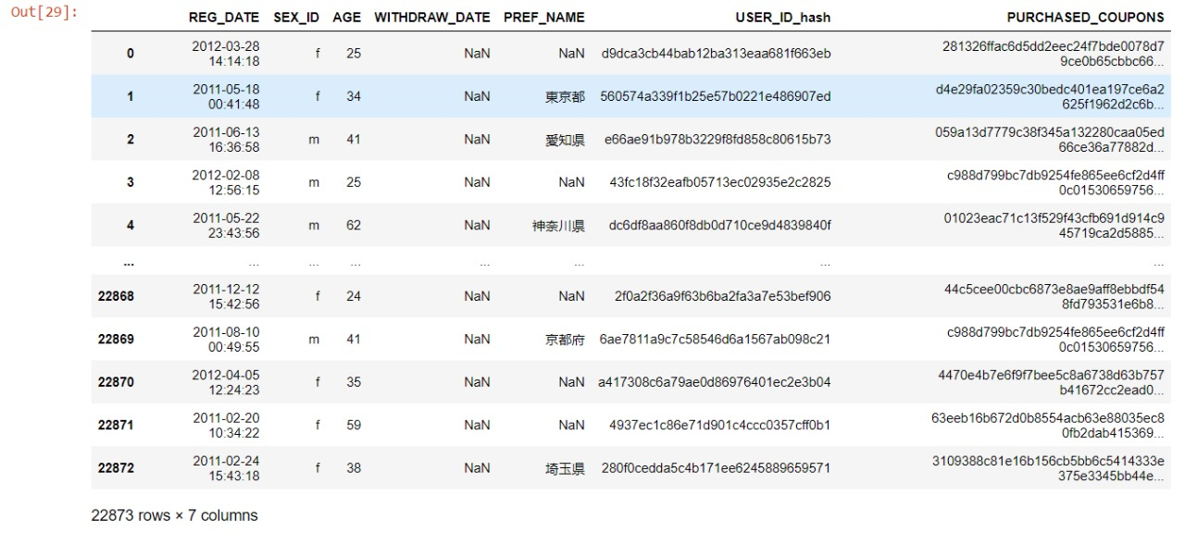
Results and Outputs

Slide 9
Conclusion
With the use of advanced analytics and machine learning, the Coupon Purchase Analysis model has the potential to revolutionize marketing and customer interactions.
The quality of the data, thoughtful feature engineering, and suitable machine learning methods are important variables impacting the effectiveness of the model.
Thorough instruction, testing, and fine-tuning are necessary to guarantee precision and prevent overfitting.
The model's use can raise conversion rates, improve customer happiness, and allocate resources optimally.
Although the model provides insightful information about consumer behavior, it is not perfect, and predictions may be impacted by other variables.
Sustained efficacy requires regular model assessment and verification against real-world results.

Slide 10
Future Scope
Customized coupon purchase forecasts and recommendations are getting better as a result of changing consumer behavior and technological advancements.
Real-time modifications can be made by incorporating dynamic input. This presents chances for future research and enhancement.
Relevance is increased by contextual recommendations that take into account variables like location and weather.
Deeper insights into customer preferences and sentiment data are provided by user-generated content analysis.
Recurrent networks are used to create sequential suggestions that increase timing-based prediction accuracy.
Reliability and precision are improved by ensemble approaches that combine prediction models.
Current recommendations are guaranteed by real-time adjustments to abrupt changes in consumer behavior.
These developments are meant to increase efficiency, personalization, and precision in order to improve marketing strategies and client interaction.

Slide 11
References
[1]Li, L., Li, X., Qi, W. et al. Targeted reminders of electronic coupons: using predictive analytics to facilitate coupon marketing. Electron Commer Res 22, 321–350 (2022). https://doi.org/10.1007/s10660-020-09405-4
[2]Pusztová, Ľudmila & Babic, Frantisek. (2020). PERFORMANCE ASSESSMENT OF DIFFERENT CLASSIFICATION METHODS FOR COUPON MARKETING IN E-COMMERCE. Acta Electrotechnica et Informatica. 20. 11-16. 10.15546/aeei-2020-0014.
[3]X. Zhai, P. Shi, L. Xu, Y. Wang and X. Chen, "Prediction Model of User Purchase Behaviour Based on Machine Learning," 2020 IEEE International Conference on Mechatronics and Automation (ICMA), Beijing, China, 2020, pp. 1483-1487, doi: 10.1109/ICMA49215.2020.9233677.
[4]Asnat Greenstein-Messica,Lior Rokach,Asaf Shabtai.Personal-Discount Sensitivity Prediction for Mobile Coupon Conversion Optimization.Journal of the Association for Information Science and TechnologyVolume 68Issue 8August 2017pp 1940–1952https://doi.org/10.1002/asi.23838
[5]Ren X, Cao J, Xu X, et al. A two-stage model for forecasting consumers’ intention to purchase with ecoupons. Journal of Retailing and Consumer Services. 2021; 59:102289. https://doi.org/10.1016/j. Jretconser.2020.102289

Slide 12
References
[6]: Langen H, Huber M (2023) How causal machine learning can leverage marketing strategies: Assessing and improving the performance of a coupon campaign. PLoS ONE 18(1): e0278937. https://doi.org/10.1371/journal. Pone.0278937
[7]Dennis Koehn, Stefan Lessmann, Markus Schaal,Predicting online shopping behaviour from clickstream data using deep learning,Expert Systems with Applications,Volume 150,2020,113342,ISSN 0957-4174,https://doi.org/10.1016/j.eswa.2020.113342.
[8]Shui-xia Chen, Xiao-kang Wang, Hong-yu Zhang, Jian-qiang Wang,Customer Purchase Analysis from the perspective of imbalanced data: A machine learning framework based on factorization machine,Expert Systems with Applications,Volume 173,2021,114756,ISSN 0957-4174,https://doi.org/10.1016/j.eswa.2021.114756.
[9]A. Utku, M. A. Akcayol, (2020). 'Deep Learning Based Prediction Model for the Next Purchase'. Advances in Electrical and Computer Engineering 20(2):35-44.

